Slide 1
Pinouts for the Accelerometer and Gyroscope

Slide 2
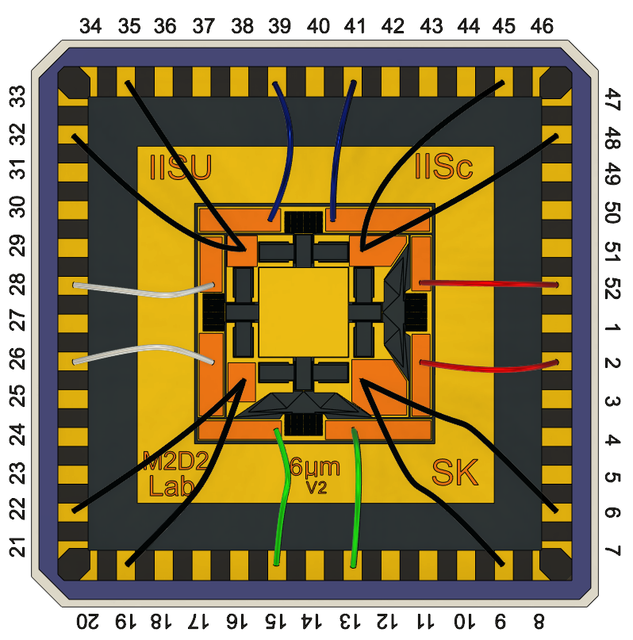
Pin Number | Colour | Description
6,9,19,22,32,35,45,48 |  | Accelerometer Common
2,52 |  | X-axis Sense Electrodes
13,15 |  | Y-axis Sense Electrodes
26,28 |  | X-axis Feedback Electrodes
39,41 |  | Y-axis Feedback Electrodes
Y
X

Slide 3
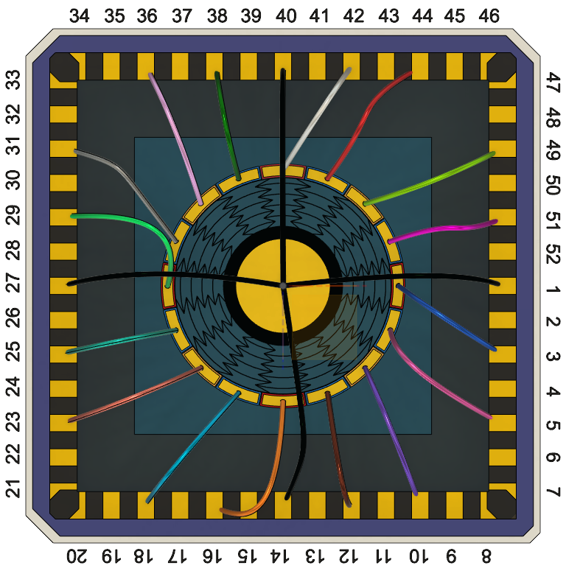
Pin Number | Colour | Description
1,14,27,40 |  | Gyroscope Common
42 |  | Outer Electrode 1
44 |  | Outer Electrode 2
49 |  | Outer Electrode 3
51 |  | Outer Electrode 4
3 |  | Outer Electrode 5
5 |  | Outer Electrode 6
10 |  | Outer Electrode 7
12 |  | Outer Electrode 8
16 |  | Outer Electrode 9
18 |  | Outer Electrode 10
23 |  | Outer Electrode 11
25 |  | Outer Electrode 12
29 |  | Outer Electrode 13
31 |  | Outer Electrode 14
36 |  | Outer Electrode 15
38 |  | Outer Electrode 16

